Slide 1
NLP Convolutional Neural Network lecture 03.4
Branko Žitko

Slide 2
Convolutional Neural Network
CNN - a type of neural network that is well suited to detecting spatial substructure (and creating meaningful spatial substructure consequently).
CNNs accomplish this by having a small number of weights they use to scan the input data tensors.
From this scanning, they produce output tensors that represent the detection (or not) of substructures.

Slide 3
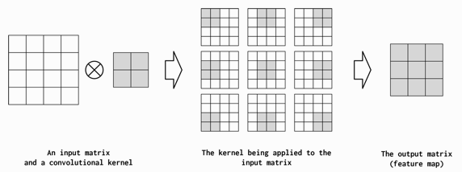
CNN Hyperparameters
An input matrix is convolved with a single convolutional kernel (filter) to produce an output matrix (also called a feature map).
The convolving is the application of the kernel to each position in the input matrix.
In each application, the kernel multiplies the values of the input matrix with its own values and then sums up these multiplications.

Slide 4
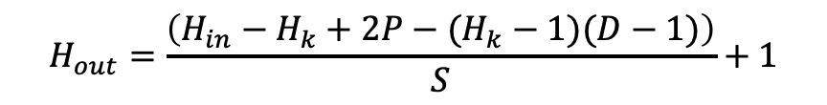
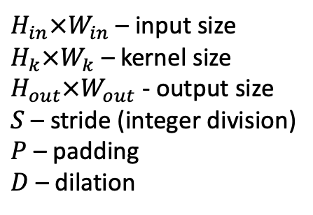
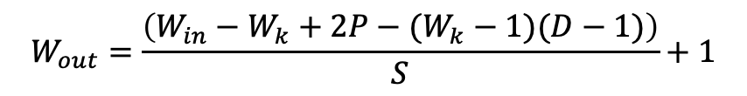
CNN Hyperparameters
kernel size – control the shape of the convolution
stride – control the positions the convolution will multiply in the input data tensor
padding - how much the input data tensor is padded with 0s
dilation - how far apart the multiplications should be when applied to the input data tensor
Calculating output size
$H_{in}×W_{in}$ – input size
$H_{k}×W_{k}$ – kernel size
$H_{out}×W_{out}$ - output size
$S$ – stride (integer division)
$P$ – padding
$D$ – dilation
$$H_{out}=\frac{\left(H_{in}−H_{k}+2P−(H_{k}−1)(D−1)\right)}{S}+1$$
$$W_{out}=\frac{\left(W_{in}−W_{k}+2P−(W_{k}−1)(D−1)\right)}{S}+1$$

Slide 5
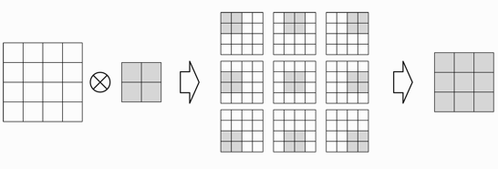
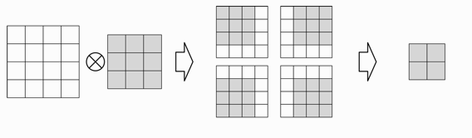
Kernel size
The width of the kernel tensor is called the kernel size.
Convolutions combine spatially (or temporally) local information in the input and the amount of local information per convolution is controlled by the kernel size.
By increasing the size of the kernel, you also decrease the size of the output.
kernel size 2
kernel size 3

Slide 6
Kernel size
Behavior of kernel size in NLP applications as being similar to the behavior of n-grams, which capture patterns in language by looking at groups of words.
With smaller kernel sizes, smaller, more frequent patterns are captured, whereas larger kernel sizes lead to larger patterns, which might be more meaningful but occur less frequently.
Small kernel sizes lead to fine-grained features in the output, whereas large kernel sizes lead to coarse-grained features.

Slide 7
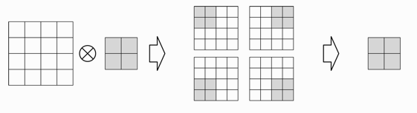
Stride
Stride controls the step size between convolutions.
If the stride is the same size as the kernel, the kernel computations do not overlap.
If the stride is 1, the kernels are maximally overlapping.
stride 1
stride 2

Slide 8
Convolving 2D stride 1 padding 0 dilation 1
input (6x6)
filter/kernel (3x3)
output (4x4)
2 | 7 | 6 | 4 | 6 | 5
0 | 4 | 0 | 3 | 8 | 4
0 | 4 | 1 | 2 | 5 | 5
7 | 6 | 9 | 6 | 3 | 1
9 | 3 | 1 | 9 | 7 | 9
2 | 0 | 5 | 9 | 3 | 4
0 | 0 | 0
0 | 1 | 0
0 | 0 | 0
4 | 0 | 3 | 8
4 | 1 | 2 | 5
6 | 9 | 6 | 3
3 | 1 | 9 | 7
$$H_{out}=\frac{H_{in}−H_{k}+2P−\left(H_{k}−1\right)\left(D−1\right) }{S}+1=\frac{6−3+0−0}{1}+1=4$$
$$W_{out}=\frac{W_{in}−W_{k}+2P−(W_{k}−1)(D−1)}{S}+1=\frac{6−3+0−0}{1}+1=4$$

Slide 9
Convolving 2D stride 1 padding 0 dilation 1
input (6x6)
filter/kernel (3x3)
output for stride 1 (4x4)
2 | 7 | 6 | 4 | 6 | 5
0 | 4 | 0 | 3 | 8 | 4
0 | 4 | 1 | 2 | 5 | 5
7 | 6 | 9 | 6 | 3 | 1
9 | 3 | 1 | 9 | 7 | 9
2 | 0 | 5 | 9 | 3 | 4
0 | 0 | 0
0 | 1 | 0
0 | 0 | 0
4 | 0 | 3 | 8
4 | 1 | 2 | 5
6 | 9 | 6 | 3
3 | 1 | 9 | 7
2 | 7 | 6
0 | 4 | 0
0 | 4 | 1
0 | 0 | 0
0 | 1 | 0
0 | 0 | 0
0 | 0 | 0
0 | 4 | 0
0 | 0 | 0
*
=
sum >
4

Slide 10
Convolving 2D stride 1 padding 0 dilation 1
S
input (6x6)
filter/kernel (3x3)
output for stride 1 (4x4)
2 | 7 | 6 | 4 | 6 | 5
0 | 4 | 0 | 3 | 8 | 4
0 | 4 | 1 | 2 | 5 | 5
7 | 6 | 9 | 6 | 3 | 1
9 | 3 | 1 | 9 | 7 | 9
2 | 0 | 5 | 9 | 3 | 4
0 | 0 | 0
0 | 1 | 0
0 | 0 | 0
4 | 0 | 3 | 8
4 | 1 | 2 | 5
6 | 9 | 6 | 3
3 | 1 | 9 | 7
7 | 6 | 4
4 | 0 | 3
4 | 1 | 2
0 | 0 | 0
0 | 1 | 0
0 | 0 | 0
0 | 0 | 0
0 | 0 | 0
0 | 0 | 0
*
=
sum >
0

Slide 11
Convolving 2D stride 1 padding 0 dilation 1
S
input (6x6)
filter/kernel (3x3)
output for stride 1 (4x4)
2 | 7 | 6 | 4 | 6 | 5
0 | 4 | 0 | 3 | 8 | 4
0 | 4 | 1 | 2 | 5 | 5
7 | 6 | 9 | 6 | 3 | 1
9 | 3 | 1 | 9 | 7 | 9
2 | 0 | 5 | 9 | 3 | 4
0 | 0 | 0
0 | 1 | 0
0 | 0 | 0
4 | 0 | 3 | 8
4 | 1 | 2 | 5
6 | 9 | 6 | 3
3 | 1 | 9 | 7
6 | 4 | 6
0 | 3 | 8
1 | 2 | 5
0 | 0 | 0
0 | 1 | 0
0 | 0 | 0
0 | 0 | 0
0 | 3 | 0
0 | 0 | 0
*
=
sum >
3

Slide 12
Convolving 2D stride 2 padding 0 dilation 1
input (6x6)
filter/kernel (3x3)
output for stride 2 (2x2)
2 | 7 | 6 | 4 | 6 | 5
0 | 4 | 0 | 3 | 8 | 4
0 | 4 | 1 | 2 | 5 | 5
7 | 6 | 9 | 6 | 3 | 1
9 | 3 | 1 | 9 | 7 | 9
2 | 0 | 5 | 9 | 3 | 4
0 | 0 | 0
0 | 1 | 0
0 | 0 | 0
4 | 3
6 | 6
$$H_{out}=\frac{H_{in}−H_{k}+2P−\left(H_{k}−1\right)\left(D−1\right) }{S}+1=\frac{6−3+0−0}{2}+1=2$$
$$W_{out}=\frac{W_{in}−W_{k}+2P−(W_{k}−1)(D−1)}{S}+1=\frac{6−3+0−0}{2}+1=2$$

Slide 13
Convolving 2D stride 2 padding 0 dilation 1
input (6x6)
filter/kernel (3x3)
output for stride 2 (2x2)
2 | 7 | 6 | 4 | 6 | 5
0 | 4 | 0 | 3 | 8 | 4
0 | 4 | 1 | 2 | 5 | 5
7 | 6 | 9 | 6 | 3 | 1
9 | 3 | 1 | 9 | 7 | 9
2 | 0 | 5 | 9 | 3 | 4
0 | 0 | 0
0 | 1 | 0
0 | 0 | 0
4 | 3
6 | 6
2 | 7 | 6
0 | 4 | 0
0 | 4 | 1
0 | 0 | 0
0 | 1 | 0
0 | 0 | 0
0 | 0 | 0
0 | 4 | 0
0 | 0 | 0
*
=
sum >
4

Slide 14
Convolving 2D stride 2 padding 0 dilation 1
S
input (6x6)
filter/kernel (3x3)
output for stride 2 (2x2)
2 | 7 | 6 | 4 | 6 | 5
0 | 4 | 0 | 3 | 8 | 4
0 | 4 | 1 | 2 | 5 | 5
7 | 6 | 9 | 6 | 3 | 1
9 | 3 | 1 | 9 | 7 | 9
2 | 0 | 5 | 9 | 3 | 4
0 | 0 | 0
0 | 1 | 0
0 | 0 | 0
4 | 3
6 | 6
6 | 4 | 6
0 | 3 | 8
1 | 2 | 5
0 | 0 | 0
0 | 1 | 0
0 | 0 | 0
0 | 0 | 0
0 | 3 | 0
0 | 0 | 0
*
=
sum >
3

Slide 15
Convolving 2D stride 2 padding 0 dilation 1
input (6x6)
filter/kernel (3x3)
output (2x2)
2 | 7 | 6 | 4 | 6 | 5
0 | 4 | 0 | 3 | 8 | 4
0 | 4 | 1 | 2 | 5 | 5
7 | 6 | 9 | 6 | 3 | 1
9 | 3 | 1 | 9 | 7 | 9
2 | 0 | 5 | 9 | 3 | 4
0 | 0 | 0
0 | 1 | 0
0 | 0 | 0
4 | 3
6 | 6
S
0 | 4 | 1
7 | 6 | 9
9 | 3 | 1
0 | 0 | 0
0 | 1 | 0
0 | 0 | 0
0 | 0 | 0
0 | 6 | 0
0 | 0 | 0
*
=
sum >
6

Slide 16
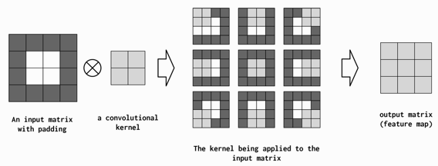
Padding
Even though stride and kernel size allow for controlling how much scope each computed feature value has, they have a detrimental, and sometimes unintended, side effect of shrinking the total size of the feature map (the output of a convolution).
To counteract this, the input data tensor is artificially made larger in length, height and/or depth by appending and prepending 0s to each respective dimension.
This consequently means that the CNN will perform more convolutions, but the output shape can be controlled without compromising the desired kernel size, stride, or dilation.

Slide 17
Convolving 2D stride 1 padding 1 dilation 1
P
padded input (6x6)
filter/kernel (3x3)
output (6x6)
P
0 | 0 | 0 | 0 | 0 | 0 | 0 | 0
0 | 2 | 7 | 6 | 4 | 6 | 5 | 0
0 | 0 | 4 | 0 | 3 | 8 | 4 | 0
0 | 0 | 4 | 1 | 2 | 5 | 5 | 0
0 | 7 | 6 | 9 | 6 | 3 | 1 | 0
0 | 9 | 3 | 1 | 9 | 7 | 9 | 0
0 | 2 | 0 | 5 | 9 | 3 | 4 | 0
0 | 0 | 0 | 0 | 0 | 0 | 0 | 0
0 | 0 | 0
0 | 1 | 0
0 | 0 | 0
2 | 7 | 6 | 4 | 6 | 5
0 | 4 | 0 | 3 | 8 | 4
0 | 4 | 1 | 2 | 5 | 5
7 | 6 | 9 | 6 | 3 | 1
9 | 3 | 1 | 9 | 7 | 9
2 | 0 | 5 | 9 | 3 | 4
P
P
$$H_{out}=\frac{H_{in}−H_{k}+2P−\left(H_{k}−1\right)\left(D−1\right) }{S}+1=\frac{6−3+2−0}{1}+1=6$$
$$W_{out}=\frac{W_{in}−W_{k}+2P−(W_{k}−1)(D−1)}{S}+1=\frac{6−3+2−0}{1}+1=6$$

Slide 18
Convolving 2D stride 1 padding 1 dilation 1
padded input (6x6)
filter/kernel (3x3)
output (6x6)
0 | 0 | 0 | 0 | 0 | 0 | 0 | 0
0 | 2 | 7 | 6 | 4 | 6 | 5 | 0
0 | 0 | 4 | 0 | 3 | 8 | 4 | 0
0 | 0 | 4 | 1 | 2 | 5 | 5 | 0
0 | 7 | 6 | 9 | 6 | 3 | 1 | 0
0 | 9 | 3 | 1 | 9 | 7 | 9 | 0
0 | 2 | 0 | 5 | 9 | 3 | 4 | 0
0 | 0 | 0 | 0 | 0 | 0 | 0 | 0
0 | 0 | 0
0 | 1 | 0
0 | 0 | 0
2 | 7 | 6 | 4 | 6 | 5
0 | 4 | 0 | 3 | 8 | 4
0 | 4 | 1 | 2 | 5 | 5
7 | 6 | 9 | 6 | 3 | 1
9 | 3 | 1 | 9 | 7 | 9
2 | 0 | 5 | 9 | 3 | 4
0 | 0 | 0
0 | 4 | 0
0 | 4 | 1
0 | 0 | 0
0 | 1 | 0
0 | 0 | 0
0 | 0 | 0
0 | 2 | 0
0 | 0 | 0
*
=
sum >
2

Slide 19
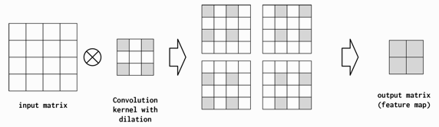
Dilation
Dilation controls how the convolutional kernel is applied to the input tensor.
Increasing the dilation from 1 (the default) to 2 means that the elements of the kernel are two spaces away from each other when applied to the input matrix.
This can be useful for summarizing larger regions of the input space without an increase in the number of parameters.
Dilated convolutions have proven very useful when convolution layers are stacked.

Slide 20
Convolving 2D stride 1 padding 0 dilation 2
input (6x6)
dilated filter/kernel (3x3)
output (2x2)
2 | 7 | 6 | 4 | 6 | 5
0 | 4 | 0 | 3 | 8 | 4
0 | 4 | 1 | 2 | 5 | 5
7 | 6 | 9 | 6 | 3 | 1
9 | 3 | 1 | 9 | 7 | 9
2 | 0 | 5 | 9 | 3 | 4
0 |  | 0 |  | 0
0 |  | 1 |  | 0
0 |  | 0 |  | 0
1 | 2
9 | 6
D
D
$$H_{out}=\frac{H_{in}−H_{k}+2P−\left(H_{k}−1\right)\left(D−1\right) }{S}+1=\frac{6−3+0−2}{1}+1=2$$
$$W_{out}=\frac{W_{in}−W_{k}+2P−(W_{k}−1)(D−1)}{S}+1=\frac{6−3+0−2}{1}+1=2$$

Slide 21
Convolving 2D stride 1 padding 0 dilation 2
input (6x6)
dilated filter/kernel (3x3)
output (2x2)
2 | 7 | 6 | 4 | 6 | 5
0 | 4 | 0 | 3 | 8 | 4
0 | 4 | 1 | 2 | 5 | 5
7 | 6 | 9 | 6 | 3 | 1
9 | 3 | 1 | 9 | 7 | 9
2 | 0 | 5 | 9 | 3 | 4
0 |  | 0 |  | 0
0 |  | 1 |  | 0
0 |  | 0 |  | 0
1 | 2
9 | 6
2 | 6 | 6
0 | 1 | 5
9 | 1 | 7
0 | 0 | 0
0 | 1 | 0
0 | 0 | 0
0 | 0 | 0
0 | 1 | 0
0 | 0 | 0
*
=
sum >
1

Slide 22
Dimension of Convolution Operation
In PyTorch, convolutions can be 1D, 2D, or 3D and are implemented by the Conv1d, Conv2d, and Conv3d modules, respectively.
1D convolutions are useful for time series in which each time step has a feature vector. We can learn patterns on the sequence dimension. Most convolution operations in NLP are one-dimensional convolutions.
2D convolution tries to capture spatio-temporal patterns along two directions in the data (images - height and width dimensions)
3D convolutions capture patterns along three dimensions in the data. (video data - frame of the image and the sequence of frames)

Slide 23
Channels
Channels refers to the feature dimension along each datapoint in the input.
In images there are three channels for each pixel in the image, corresponding to the RGB components.
Conceptually, if "pixels" in a text document are words, the number of channels is the size of the vocabulary.
Considering convolution over characters, the number of channels is the size of the character set (which happens to be the vocabulary in this case).

Slide 24
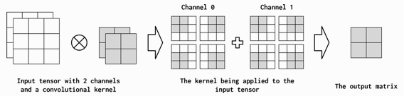
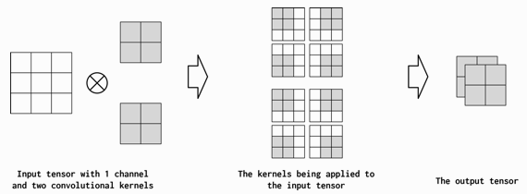
Channels
It’s difficult to immediately know how many output channels are appropriate for the problem at hand.
A common design pattern is not to shrink the number of channels by more than a factor of two from one convolutional layer to the next.
This is not a hard-and-fast rule, but it should give some sense of what an appropriate number of output channels would look like.
input channels 2
output channels 2
input channels 1
output channels 2

Slide 25


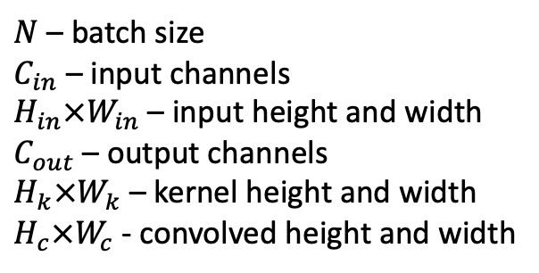

Convolving 2D stride 2
input (1x2x4x4)
filter/kernel (4x2x3x3)
output for stride 1 (1x4x2x2)
$$N×C_{in}×H_{in}×W_{in}$$
$$C_{out}×C_{in}×H_{k}×W_{k}$$
$$N×C_{out}×H_{c}×W_{c}$$
5 | 5 | 7 | 6
9 | 6 | 3 | 1
9 | 3 | 1 | 9
7 | 9 | 2 | 0
0 | 1 | 0
0 | 0 | 0
0 | 0 | 0
7 | 14
12 | 8
1 | 0 | 0
0 | 0 | 0
0 | 0 | 0
2 | 7 | 6 | 4
6 | 5 | 0 | 4
0 | 3 | 8 | 4
0 | 4 | 1 | 2
0 | 0 | 0
1 | 0 | 0
0 | 0 | 0
15 | 10
9 | 7
0 | 0 | 1
0 | 0 | 0
0 | 0 | 0
0 | 0 | 0
0 | 0 | 1
0 | 0 | 0
8 | 1
4 | 17
0 | 0 | 0
0 | 1 | 0
0 | 0 | 0
$N$ – batch size
$C_{in}$ – input channels
$H_{in}×W_{in}$ – input height and width
$C_{out}$ – output channels
$H_{k}×W_{k}$ – kernel height and width
$H_{c}×W_{c}$ - convolved height and width
0 | 0 | 0
0 | 0 | 0
0 | 1 | 0
3 | 4
9 | 6
0 | 0 | 0
0 | 0 | 0
1 | 0 | 0

Slide 26
The Multilayer Perceptron
The multilayer perceptron is considered one of the most basic neural network building blocks.
The simplest MLP is an extension to the perceptron.
The perceptron takes the data vector as input and computes a single output value.
In an MLP, many perceptrons are grouped so that the output of a single layer is a new vector instead of a single output value

Slide 27
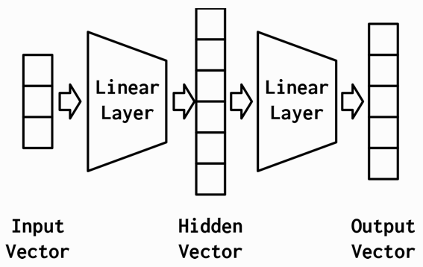
The Multilayer Perceptron
The simplest MLP is composed of
three stages of representation and
two Linear layers
The First stage is the input vector
The First linear layer computes a hidden vector
The Second stage is that hidden vector
The Second linear layer computes an output vector

Slide 28
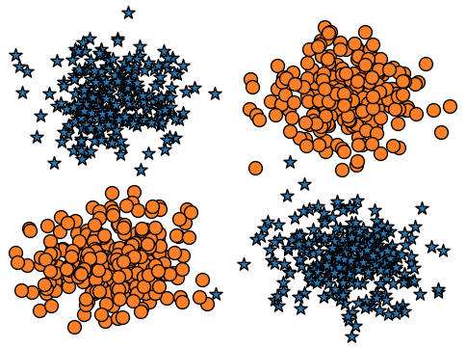
A Simple Example: XOR
Two classes in the XOR dataset plotted as circles and stars.
Perceptron
MLP

Slide 29
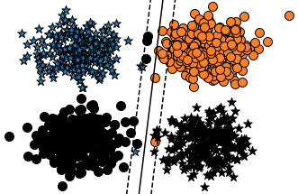
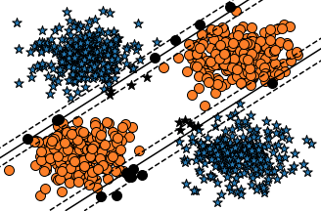
A Simple Example: XOR
The decision boundary cannot be a single straight line (linearly separable)
It appears that the MLP has two decision boundaries, and that is its advantage, it is actually just one decision boundary!
The decision boundary just appears that way because the intermediate representation has morphed the space to allow one hyperplane to appear in both of those positions.
Perceptron
MLP

Slide 30
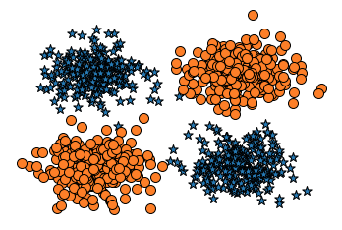
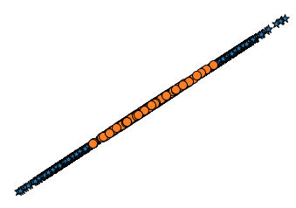
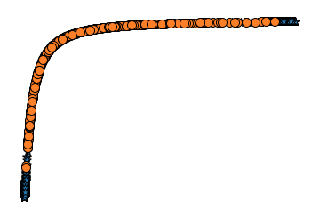
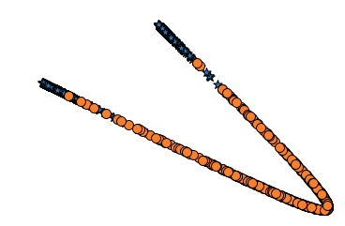
A Simple Example: XOR
MLP has learned to “warp” the space in which the data lives so that it can divide the dataset with a single line by the time it passes through the final layer.
1. input to the nework
2. output of the first linear module
3. output of the first nonlinearity
4. output of the second linear module

Slide 31
The Multilayer Perceptron
Because of the sequential nature of the layers, you must take care to ensure that the number of outputs in a layer is equal to the number of inputs to the next layer. ModuleList will be list of input and hidden layers fully connected layer is at the end last_forward_cache will be used to store layer's output
import torch class MultilayerPerceptron(torch.nn.Module): def __init__(self, input_size, hidden_size=2, output_size=3, num_hidden_layers=1, hidden_activation=torch.nn.Sigmoid): super(MultilayerPerceptron, self).__init__() self.module_list = torch.nn.ModuleList() # (1) interim_input_size = input_size interim_output_size = hidden_size for _ in range(num_hidden_layers): self.module_list.append(torch.nn.Linear(interim_input_size, interim_output_size)) self.module_list.append(hidden_activation()) interim_input_size = interim_output_size self.fc_final = torch.nn.Linear(interim_input_size, output_size) # (2) self.last_forward_cache = [] # (3)

Slide 32
The Multilayer Perceptron
Because of the sequential nature of the layers, you must take care to ensure that the number of outputs in a layer is equal to the number of inputs to the next layer. store input data store outputs of first n – 1 layers store outputs of final layer apply softmax
def forward(self, x, apply_softmax=False): self.last_forward_cache = [] self.last_forward_cache.append(x.to("cpu").numpy()) # (1) for module in self.module_list: x = module(x) # (2) self.last_forward_cache.append(x.to("cpu").data.numpy()) output = self.fc_final(x) self.last_forward_cache.append(output.to("cpu").data.numpy()) # (3) if apply_softmax: output = F.softmax(output, dim=1) # (4) return output

Slide 33
The Multilayer Perceptron
Multilayer perceptron with 1 hidden layer
mlp = MultilayerPerceptron(input_size=2, hidden_size=2, num_hidden_layers=1, output_size=2) mlp
MultilayerPerceptron( (module_list): ModuleList( (0): Linear(in_features=2, out_features=2, bias=True) (1): Sigmoid() ) (fc_final): Linear(in_features=2, out_features=2, bias=True) )

